Slide 1
Big Question
Which x-axis characteristics are most meaningful (Hazard identification)?
Particle counts vs. mass vs. volume vs. surface area, etc.
Do we need to break out separate answers for size, type, shape of microplastics?

Slide 2
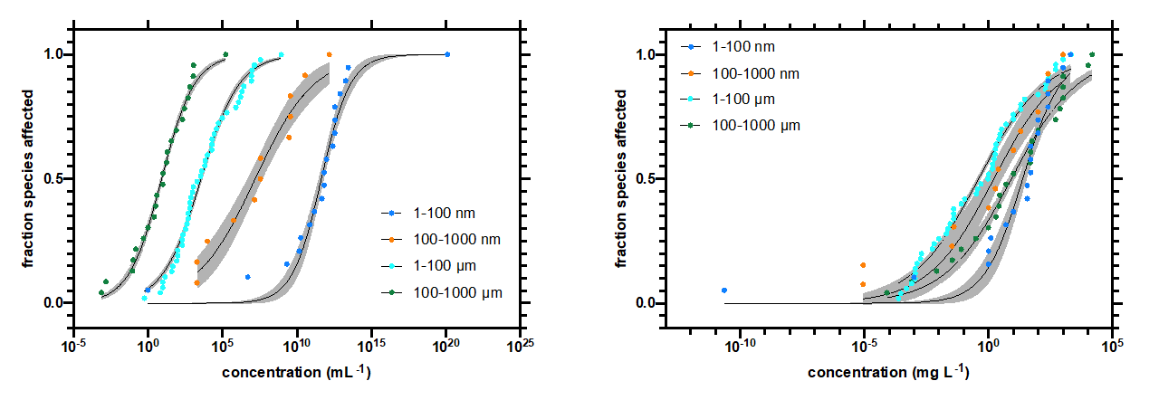
Background: Size Matters (mass and count)
Particles/mL
SSD analysis by Martin Wagner

Slide 3
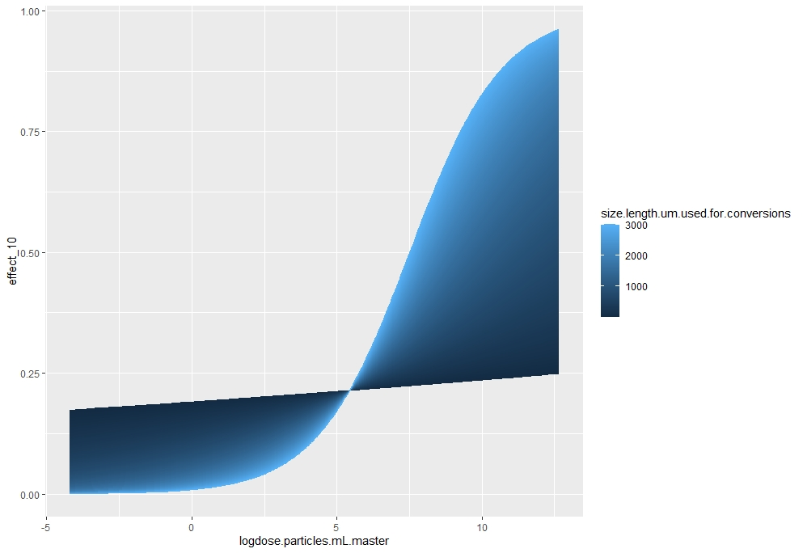
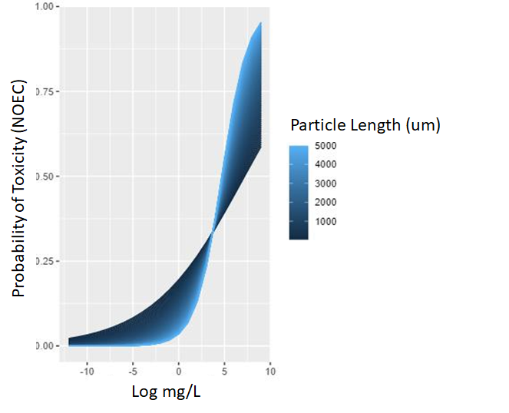
Size Matters MOST for Particle Count, Mass too
Crustacea, Fitness, Organism-level Effects Only

Slide 4
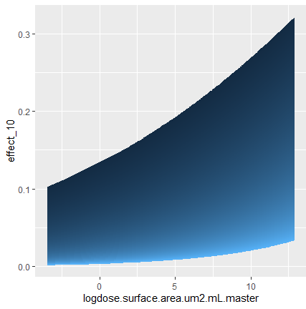
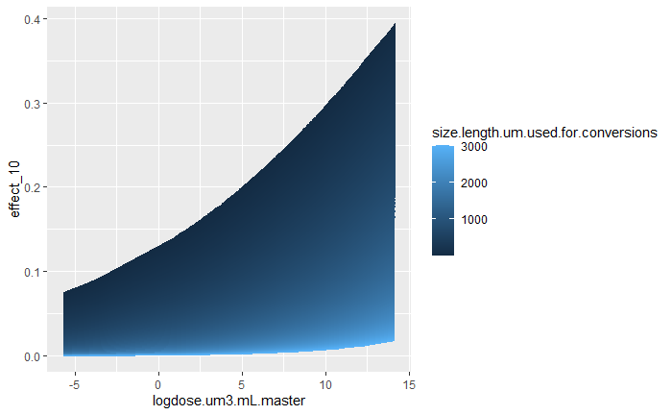
Fitness, Organism-level Effects Only

Slide 5
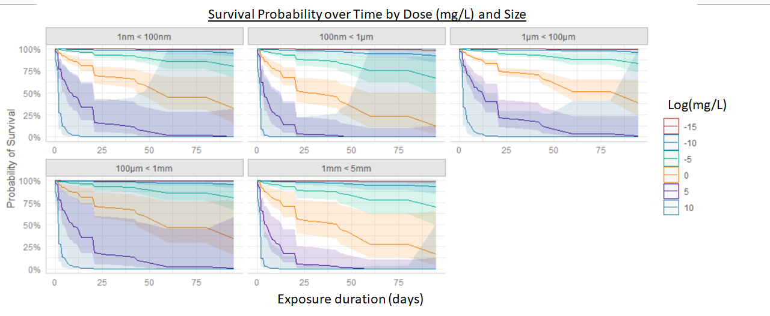
Effects More Consistent Among Sizes When Controlling for Factors
Organismal Fitness Endpoints; General Linear Model

Slide 6
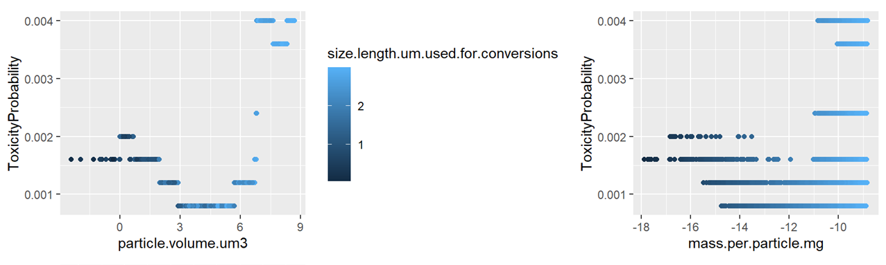
Machine Learning Predicts Higher Toxicity for Smaller and Larger Particles
Random Forest Toxicity Prediction (probability) for each particle in uniform microplastics distribution (n = 10,000)
Random Forest Prediction Accuracy = 91%

Slide 7
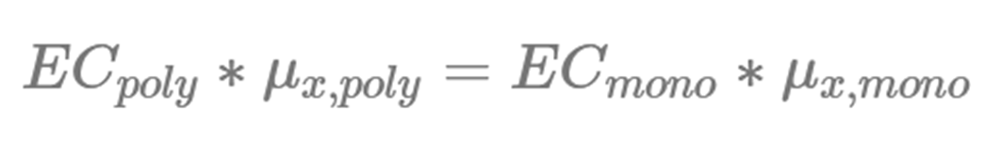
Alignment Techniques for Volume, Mass, Surface Area, Particle Count, Specific Surface Area Exist
Estimated mean value
for the given ERM x
Known value
for the given ERM x
Known Effect concentration for monodisperse particles
Calculated Effect Concentration
Kooi et al (2021); Submitted

Slide 8
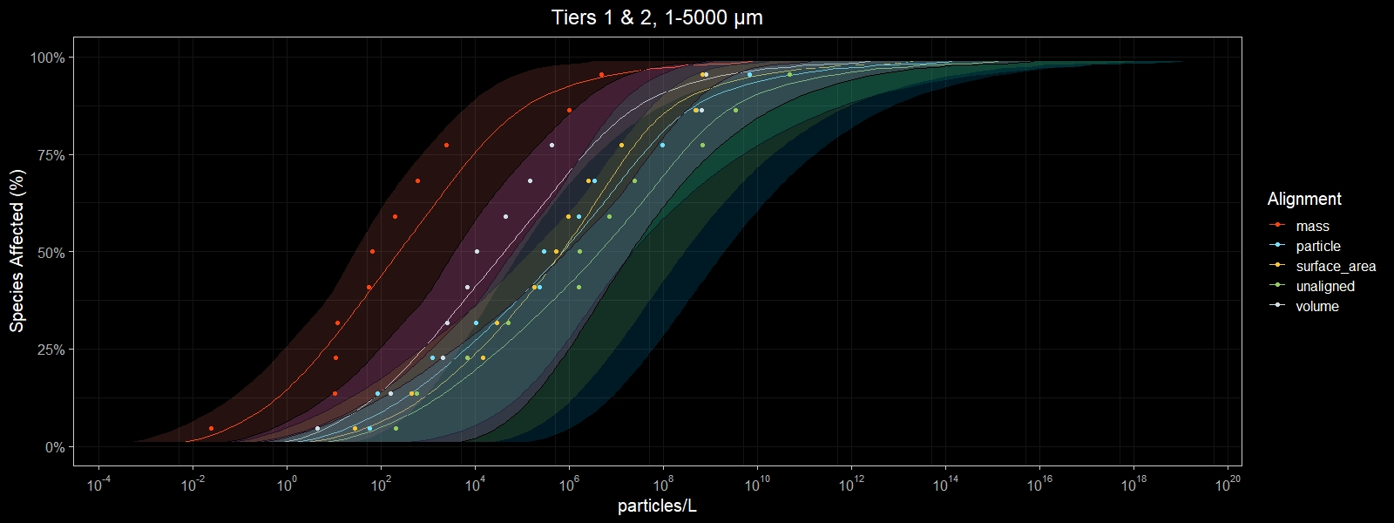
Alignment Techniques for Volume, Mass, Surface Area, Particle Count, Specific Surface Area Exist
Tox data from 1-5,000 um, aligned to 1-5,000 um by various ERM

Slide 9
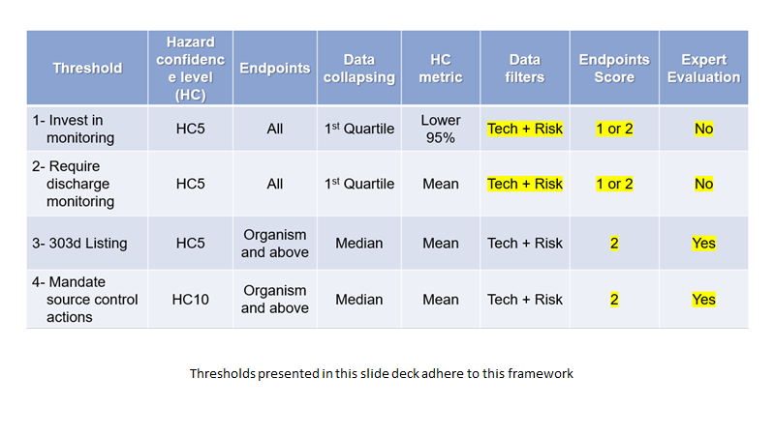

Slide 10
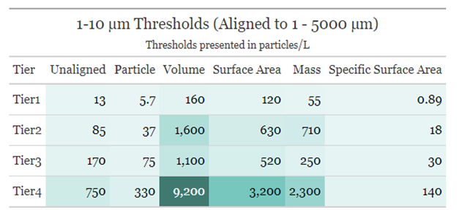
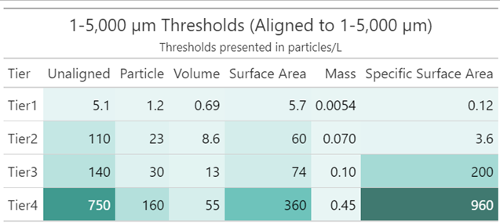
Choosing the ERM of Interest
Oxidative Stress
Food Dilution

Slide 11
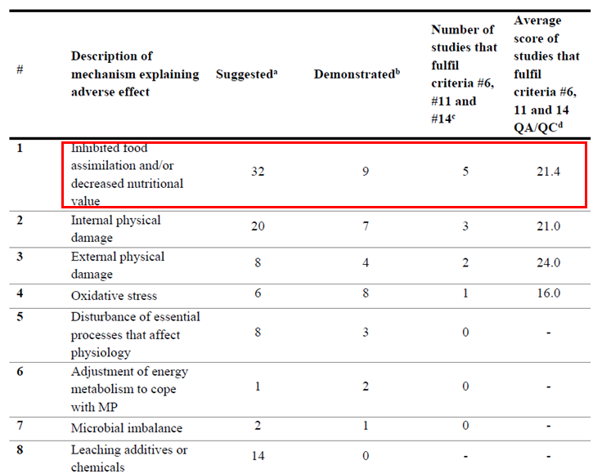
Strong Evidence: Volume as Dose Metric for Food Dilution
De Ruijter et al (2020), ES&T

Slide 12
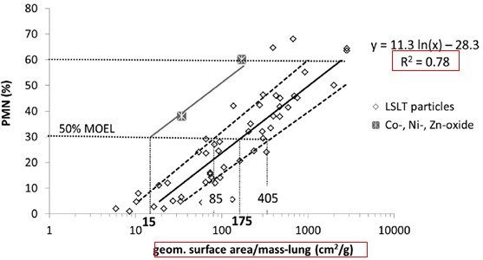
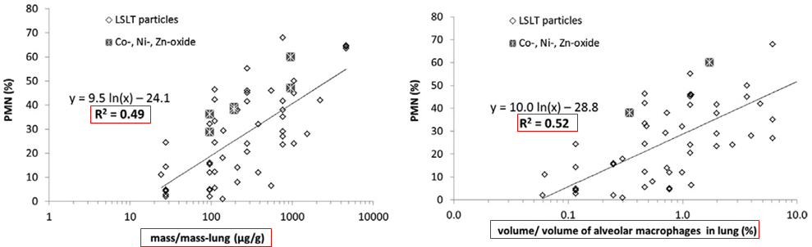
Evidence from Nanoparticle Literature: Surface Area as Dose Metric for Oxidative Stress
“The absence of any significant size-dependent particle toxicity is remarkable and documents the biological relevance of surface area as dose metric.”
(Schmid & Stoeger, Journal of Aerosol Science 2016)

Slide 13
Needed: Evidence from Microplastics Data for Surface Area as Predictor of Toxicity

Slide 14
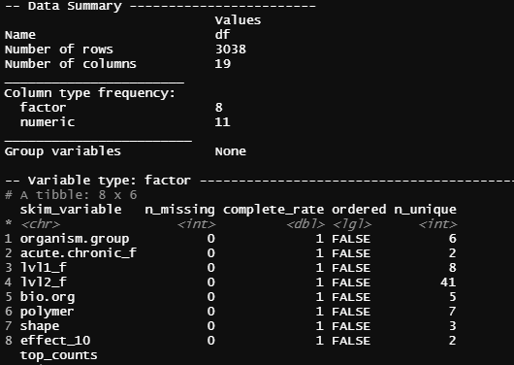
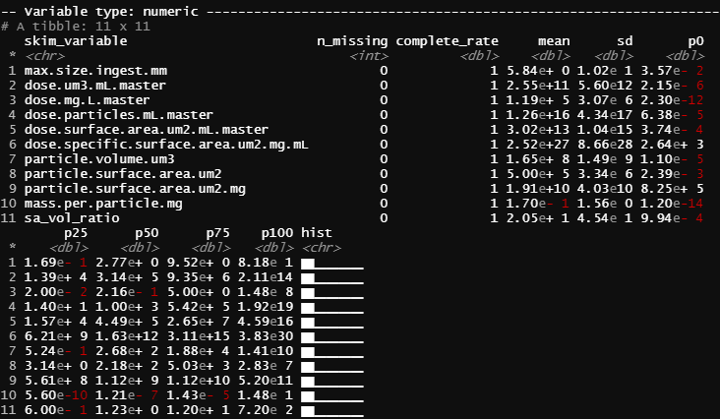
Dataset Analysis
Numeric
Character

Slide 15
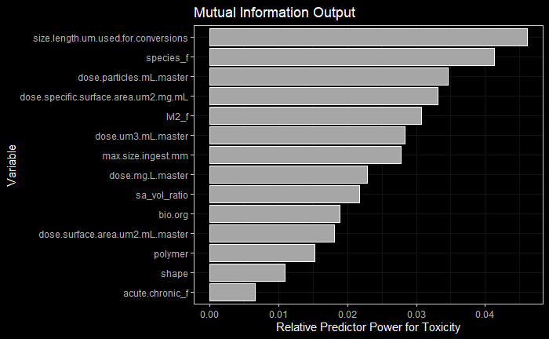

Slide 16
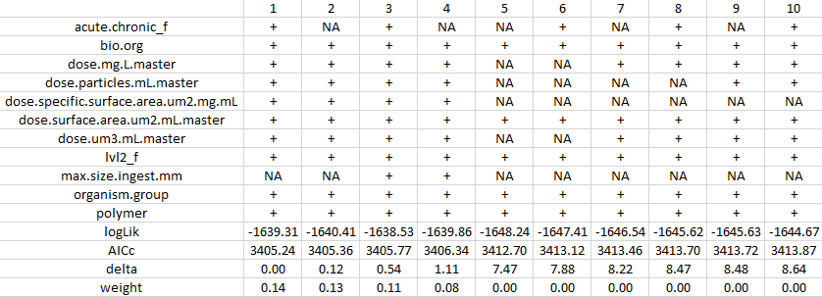
Complete Stepwise Regression Analysis: Top Ten Models

Slide 17
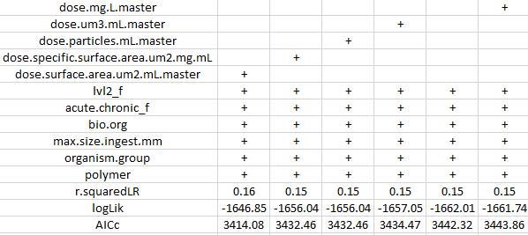
Relative Model Accuracy by Dose Metrics

Slide 18
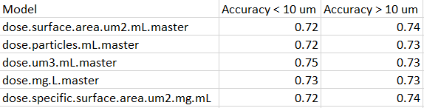
Comparing Accuracy by Size Group

Slide 19
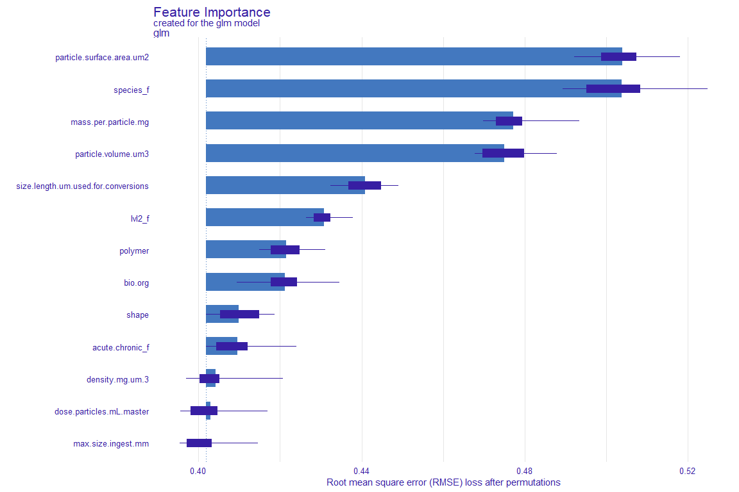

Slide 20
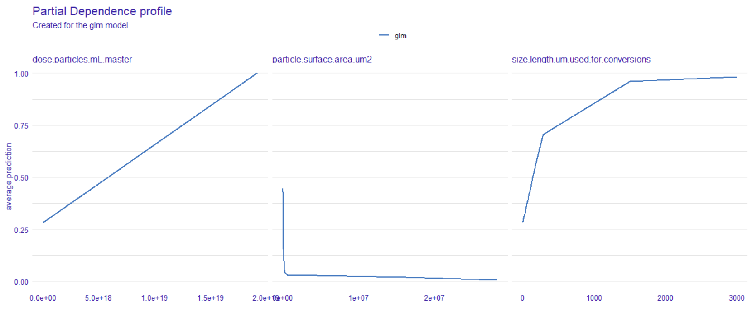

Slide 21
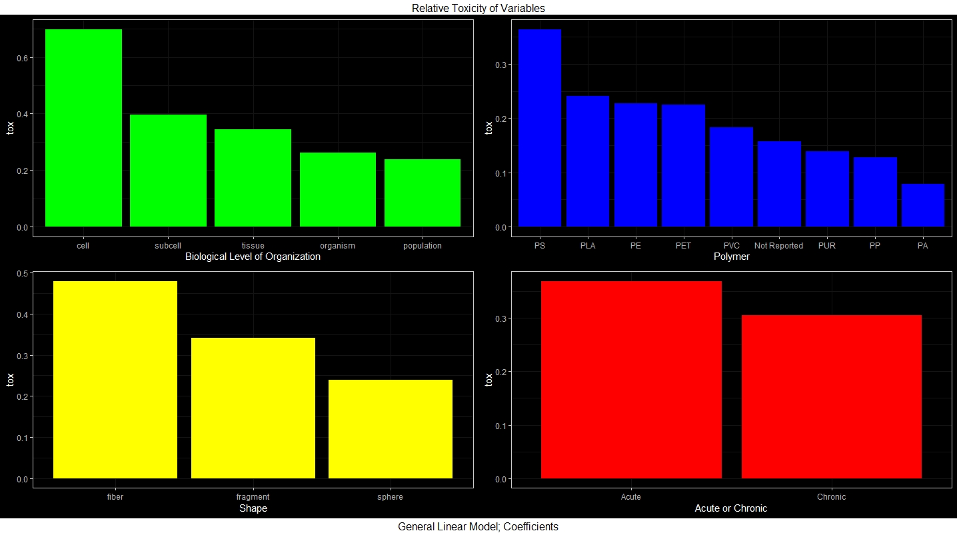
General Linear Model: n = 3,062; quality filtered; Accuracy = 0.71

Slide 22
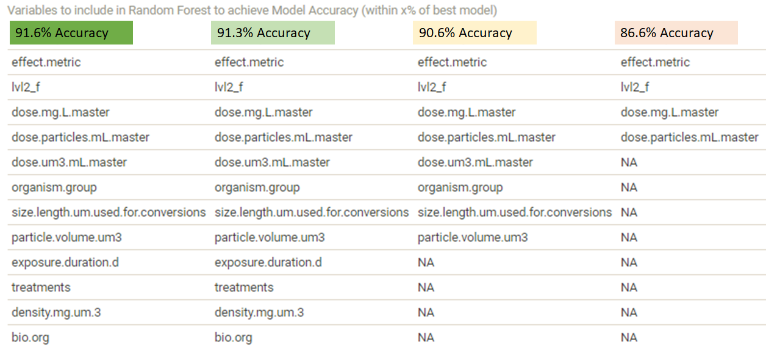

Slide 23
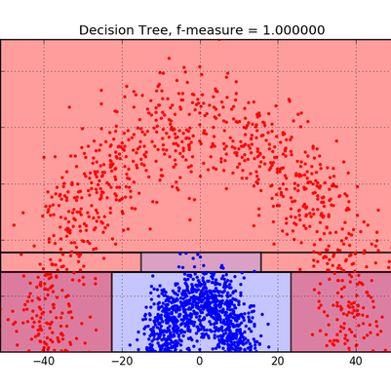
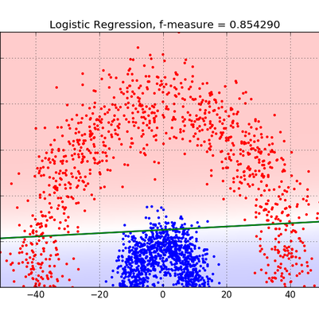
Decision Trees vs. Logistic Regression
blog.bigml.com

Slide 24
Bart’s Comments
· Dose Metric
o Do more specific hypotheses testing. Restrict endpoint types.
· Could make matrix of research questions and show what our analyses answered
· Problem – different statistical tools do similar things. Is it over-parametrized or not? Right fit, wrong answer. What’s a good decision tree for going forward?
o 1) Scientific question
o 2) Statistical significance
o 3) Pragmatic – accuracy, easy to measure
· The fact that dose metrics are important is good!
· Polymers – look at sensitivity. If we change something related to PS by 10%, how much would output change. Formal sensitivity analysis needed – not the significance.
· If we understand toxicity here, it may not apply to environment.
· Stepwise multiple regression
· Need to break out different species/endpoints THEN test predictability of dose metrics
· No smoking gun! Different metrics matter in different circumstance

Slide 25
Can be more insightful to look at specific mechanism by maximizing chance of ruling out other effect mechanisms. Take approach of de Ruijter et al (2020): ingested, food dilution demonstrated, etc.
· Try to use effect score instead of effect_10
o Look at best ten models. If models differ by effect metric, could
· Can we determine if volume matters for lvl2_f?
· Sensitivity analysis – how do changes affect the output? If we remove one variable and change others, what happens. Metric would be sensitivity of model. WIN – could do bootstrapping to determine significance of coefficients for each factor.
· Need to MOTIVATE one approach over another. There’s a story to be told.
· What is a simple model? Maybe there is no simple model for this situation. Organisms, particle types, experimental design.
· FINAL ANSWER: there is a SUITE of metrics needed to determine toxicity. Now- how can we measure them or find clever ways to equate things to one another. For example, simulated distributions.
· Look at SMALL particles with LARGE organisms to determine if oxidative stress is the culprit. Could also do that with SSDs.
o Divide body length by particle volume.
o Lower part of Jams regression has benthic organisms.
o Translocation is a distribution. Stochastic – relates to particle orientation, etc. Will not a bright cutoff.
o Decision tree may be good model for determining cutoffs
· Do we want to provide a final answer or do we want to initiate a new line of thinking/approach? Latter is Bart’s preferred thing. In several years, data quantity may double. Challenge now is to frame this as a method to get a more refined view on effect mechanisms.

Slide 26
Look at just Oxidative Stress Endpoints
Susanne:
...about oxidative stress, looking at the AOP Wiki, there are proposed pathways that link oxidative stress to p38 MapK activation, which can then cause downstream events such as apoptosis… https://aopwiki.org/events/1279 links this to reproductive failure, but that seems like a big jump to make (1279 is still under development).
This one also jumped out at me: https://aopwiki.org/events/151 ... it links oxidative stress to immune response following tissue injury, which connects with some of what we’ve already been discussing in the drinking water threshold group on the mechanical stress / inflammation that may be caused by translocated particles: “…pattern recognition receptors can be activated by endogenous danger-associated molecular patterns (DAMPs), released under oxidative stress and cell damage and include components of the extracellular matrix generated after tissue injury” … the tissue injury link may be the easiest way to loosely connect what is happening at the molecular level with organism level responses? The line would be, erm, dashed rather than solid.
I had started a folder a couple of weeks ago as part of the work on AOPs for that group, but we can use it here too if that makes sense.

